Slide 1


SAPTHAGIRI COLLEGE OF ENGINEERING
(Affiliated to Visvesvaraya Technological University, Belagavi& Approved by AICTE, New Delhi)
(Accredited by NAAC with “A” grade) (NBA Accredited-CSE,ECE,EEE,ISE,ME)
(An ISO 9001:2015 & ISO 14001:2015 Certified)
Department of Information Science & Engineering
Internship Presentation
on
“Prediction of Whether the students will pass in the law exam or not using K Nearest Neighbors
And
Classify different type of objects (laptop,speaker,table,mobile) ”
Presented by:
NAME
USN
Chirag Tilwani 1SG20IS023
Under the guidance of
Prof. Priyanka M R
Assistant Professor,
Dept. of I.S.E., S.C.E.
2023-2024

Slide 2
INTRODUCTION ABOUT THE COMPANY
The company offers broad range of customized software applications powered by concrete technology and industry expertise. It also offers end to end embedded solutions and services. They deal with broad range of product development along with customized features ensuring at most customer satisfaction and also empower individual with knowledge, skills and competencies that assist them to escalate as integrated individuals with a sense of commitment and dedication.
DEPT. OF I.S.E.,S.C.E Artificial Intelligence And Machine Learning Page 1

Slide 3
OVERVIEW OF THE ORGANISATION
VISION
To Empower Unskilled Individual with knowledge, skills and technical competencies in the field of Information Technology and Embedded engineering which assist them to escalate as integrated individuals contributing to company’s and Nation’s growth.
MISSION
Provide cost effective and reliable solutions to customers across various latest technologies.
Offer scalable end-to-end application development and management solutions
Provide cost effective highly scalable products for varied verticals.
Focus on creating sustainable value growth through innovative solutions and unique partnerships.
Create, design and deliver business solutions with high value and innovation by leveraging technology expertise and innovative business models to address long-term business objectives.
Keep our products and services updated with the latest innovations in the respective requirement and technology.
DEPT. OF I.S.E.,S.C.E Artificial Intelligence and Machine Learning Page2

Slide 4
COMPANY’S OBJECTIVES
To develop software and Embedded solutions and services focusing on quality standards and customer values.
Offer end to end embedded solutions which ensure the best customer satisfaction.
To build Skilled and Talented manpower pool for global industry requirements.
To develop software and embedded products which are globally recognized.
To become a global leader in Offering Scalable and cost-effective Software solutions and services across various domains like E-commerce, Banking, Finance, Healthcare and much more.
To generate employment for skilled and highly talented youth of our Country INDIA.
DEPT. OF I.S.E.,S.C.E Artificial Intelligence and Machine Learning Page 3

Slide 5
TASK PERFORMED
LEARNING EXPERIENCE
The value that I have gained is to always work hard even if the task is small and it seems unimportant. It helped me to build a good work idea, and the effort could be seen.
My co-workers had a lot of experience I have talked to them and asked for some advice they have for me.
I could learn a lot and get more ideas. I think this internship is extremely cherished by me.
The internship enhanced my skill and ability to work in a team. The internship allowed me to gain experience and develop interpersonal skills which made me an attractive candidate.
It also means that we have learned many things. My strength in the internship is that I am a good team builder. As a member of the team, I am responsible in group discussions and giving my own opinions.
DEPT. OF I.S.E.,S.C.E Artificial Intelligence and Machine Learning Page 4

Slide 6
KNOWLEDGE ACQUIRED
The knowledge I have gained in our training is about Artificial Intelligence and Machine Learning. I have learnt many things about the science of collecting, analyzing and preprocessing raw data to train my machine learning model effectively.
Machine learning models can process vast amounts of data quickly and accurately, making it possible to analyze and understand complex data sets that would be impossible for humans to process on their own.
Machine learning models can make accurate predictions and forecasts based on historical data, allowing businesses to make informed decisions and plan for the future.
It has been a great technical learning experience as it is thought to me a lot about various machine learning algorithms and appropriate use of it really improved my technical knowledge and skills.
DEPT. OF I.S.E.,S.C.E Artificial Intelligence and Machine Learning Page 5

Slide 7
SKILLS LEARNED
Python
Numpy
Pandas
Matplotlib
MACHINE LEARNING ALGORITHMS
Linear Regression
Multiple Linear Regression
Logistic Regression
K Nearest Neighbor
Support Vector Machine
Decision Tree
DEPT. OF I.S.E.,S.C.E Artificial Intelligence and Machine Learning Page 6

Slide 8
MOST CHALLENGING TASK PERFORMED
The most challenging task was to learn to work with resilience and patience. During my internship in artificial intelligence and machine learning, the most challenging task I encountered was refining the prediction models for whether the students will pass in the law exam or not classification using k-nearest neighbor algorithm.
This involved not only understanding the complex relationships within the dataset but also fine-tuning the
logistic parameters to achieve optimal classification accuracy.
Alongside this, the classification of laptop,speaker,table and mobile in the artificial intelligence project presented its own set of challenges.
Overall, these challenges required perseverance, critical thinking, and continuous experimentation to deliver effective solutions in both projects.
DEPT. OF I.S.E.,S.C.E Artificial Intelligence and Machine Learning Page 7

Slide 9
MACHINE LEARNING PROJECT
PREDICTION OF WHETHER THE STUDENTS WILL PASS IN THE LAW EXAM OR NOT USING K NEAREST NEIGHBORS
PROBLEM STATEMENT
Develop a machine learning model using the K-Nearest Neighbors (KNN) algorithm to predict whether a law student is likely to pass or fail the upcoming exam.
Inputs: ‘decile3’, ‘decile1’, ‘sex’, ‘lsat’, ‘ugpa’, ‘grad’, ‘fulltime’, ‘fam_inc ’, ‘parttime’, ‘male’, ‘race1’, ‘tier’, ‘tier’, ‘decile1b’.
Output : ‘pass_bar ’.
ALGORITHM – K-Nearest Neighbors
The K-Nearest Neighbors (KNN) algorithm is a popular machine learning technique used for classification and regression tasks. It relies on the idea that similar data points tend to have similar labels or values..
DEPT. OF I.S.E.,S.C.E Artificial Intelligence and Machine Learning Page 8

Slide 10
ARTIFICIAL INTELLIGENCE PROJECT
CLASSIFICATION OF LAPTOP,SPEAKER,TABLE AND MOBILE
PROBLEM STATEMENT
Create an artificial intelligence system capable of accurately distinguishing laptop,speaker,table and mobile.The project involves training to recognize key visual features that differentiate between laptop,speaker,table and mobile.
DEPT. OF I.S.E.,S.C.E Artificial Intelligence and Machine Learning Page 9

Slide 11
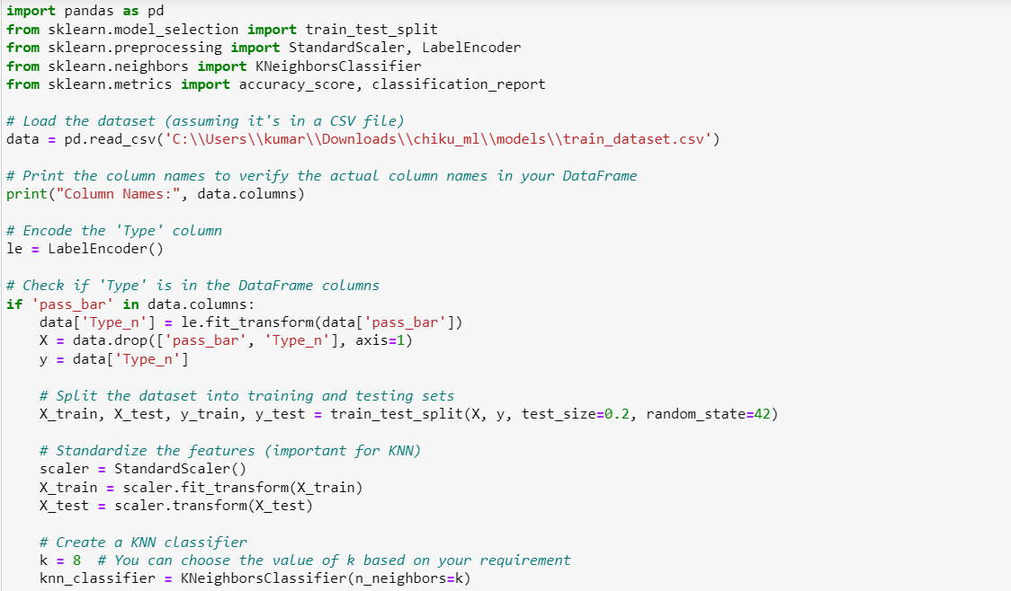
REFLECTIONS
CODE SNIPPET OF PREDICTION OF WHETHER STUDENT WILL PASS OR FAIL
DEPT. OF I.S.E.,S.C.E Artificial Intelligence and Machine Learning Page 10

Slide 12
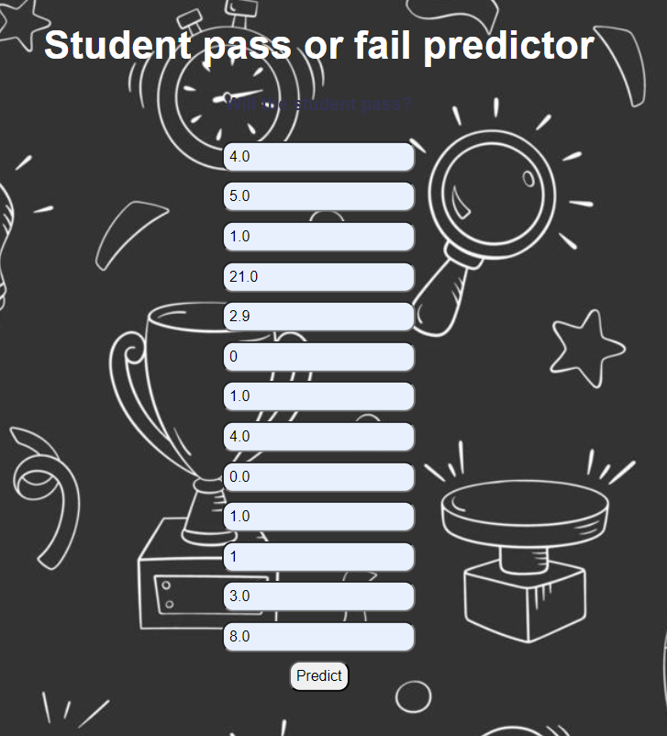
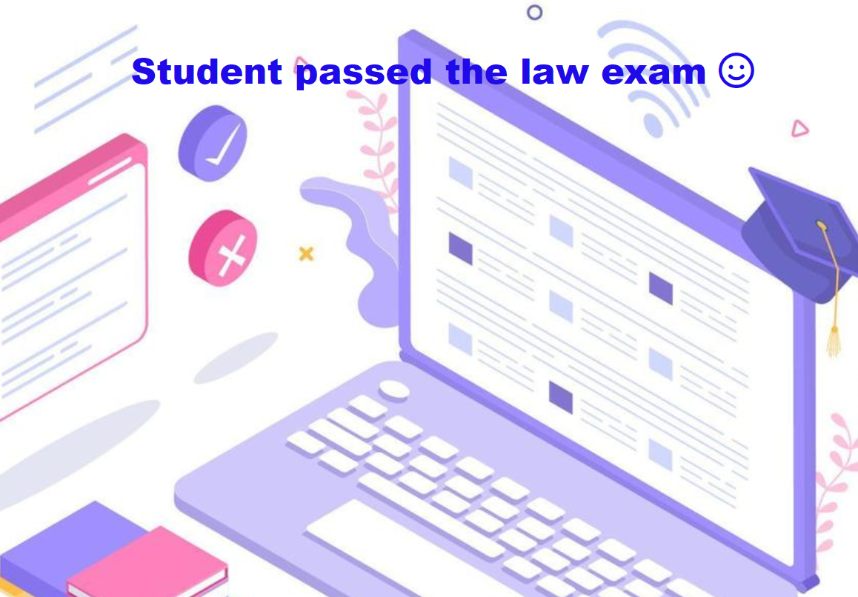
OUTPUT
DEPT. OF I.S.E.,S.C.E Artificial Intelligence and Machine Learning Page 11

Slide 13
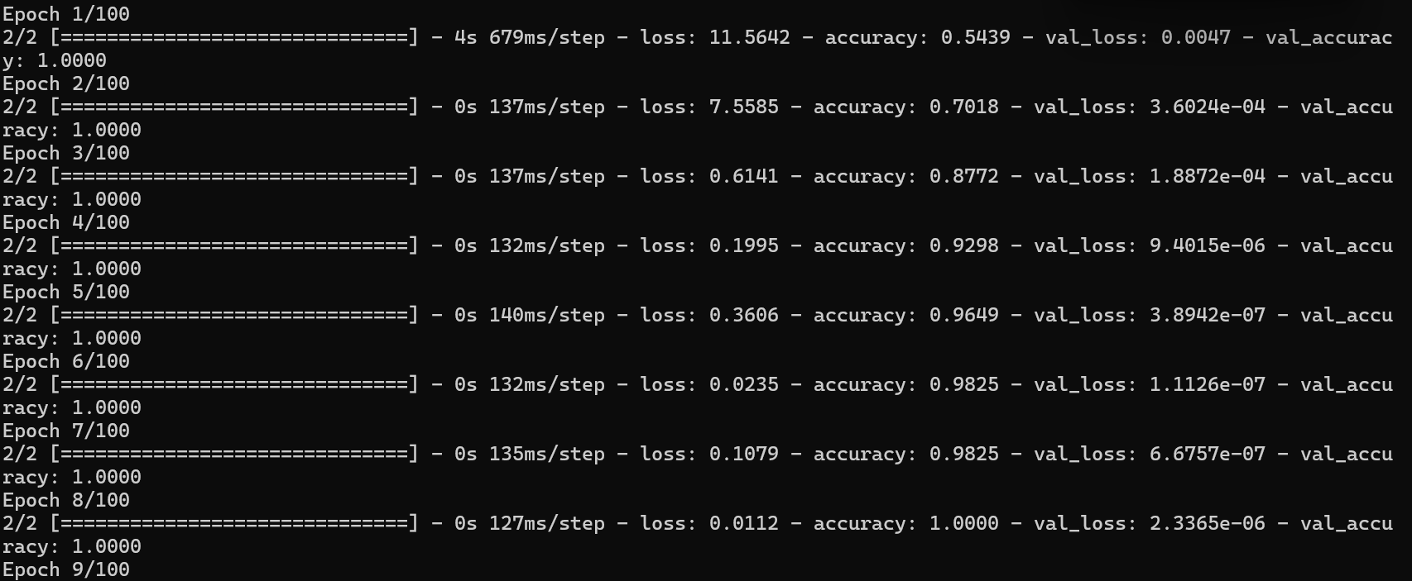
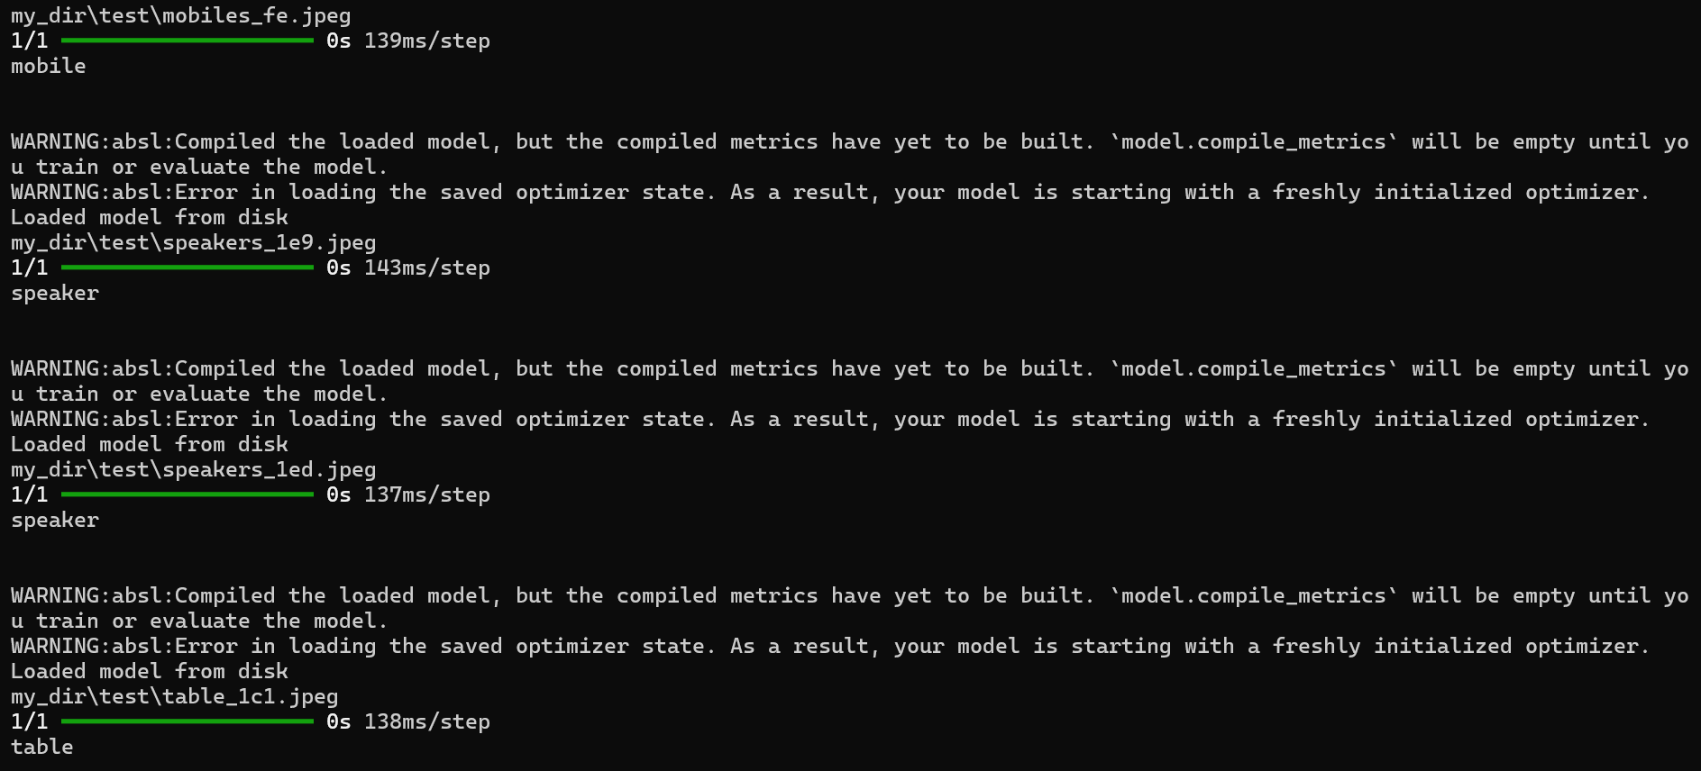
TRAINING AND TESTING DATA
Training the data
Testing the data
DEPT. OF I.S.E.,S.C.E Artificial Intelligence and Machine Learning Page 12

Slide 14
CONCLUSION
The internship aims to use Python programming language for Artificial Intelligence and Machine Learning so as to apply the theoretical knowledge to solve real-time and complex problems. The internship helped to find appropriate prediction model to the problems by applying suitable learning algorithm which can be used in future. The internship project assigned by the company helped to improve programming skills and to implement basic knowledge for solving real world problem. In this project K-Nearest Neighbors Algorithm is used to predict the Whether the students will pass in the law exam or not. The initial linearity test has been considered in the program to satisfy the linearity. The Outcome varies based on the inputs given in the Student dataset. Artificial intelligence can be employed to classify laptop, speaker, table and mobile based on various features and attributes.
DEPT. OF I.S.E.,S.C.E Artificial Intelligence and Machine Learning Page 13

Slide 15
THANK YOU

